Slide 1
Focusing on form in mixed classes without losing your focus
Melissa A. Bowles
5th Symposium on Spanish as a Heritage Language
April 6, 2018

Slide 2
Introduction
Who I am/how I got here
How many people in the audience…
Teach K-12?
Elementary?
Middle?
High school?
Teach post-secondary?
Teach heritage-only classes?
Teach mixed (L2 and heritage) classes?

Slide 3
Objectives
Part 1
Understand key research findings about instructed heritage language acquisition
Understand what research tells us about mixed classes
Be able to articulate why focus on form is important
Be able to identify what techniques are focus on form and what techniques are not
Part 2
Plan a lesson including focus on form appropriate to your students’ goals, needs, and level

Slide 4
The need to develop appropriate, effective language and literacy programs for this diverse population has become critical (Carreira & Kagan, 2011; Roca & Colombi, 2003; Valdes, 2006).

Slide 5
Research has indicated that curricula designed for foreign language (FL) students are largely inappropriate for HL students (Carreira & Kagan, 2011; Oh & Au, 2005; Peyton, Carreira, Wang, & Wiley, 2008).

Slide 6
HL learners’ language development may differ from that of L2 learners due to their different language learning experience.
Limited empirical evidence on the specific ways in which their development differs and on how those differences may affect learning outcomes in instructed contexts.

Slide 7
Adding to the complexity, heritage and L2 learners are often enrolled together in the same classrooms (Beaudrie, 2012).
And even when separate courses or ‘tracks’ exist, the two groups of learners are eventually intermingled (in upper-level content courses, for instance).

Slide 8
So how can we meet the needs of both types of learners?
What does research tell us?

Slide 9
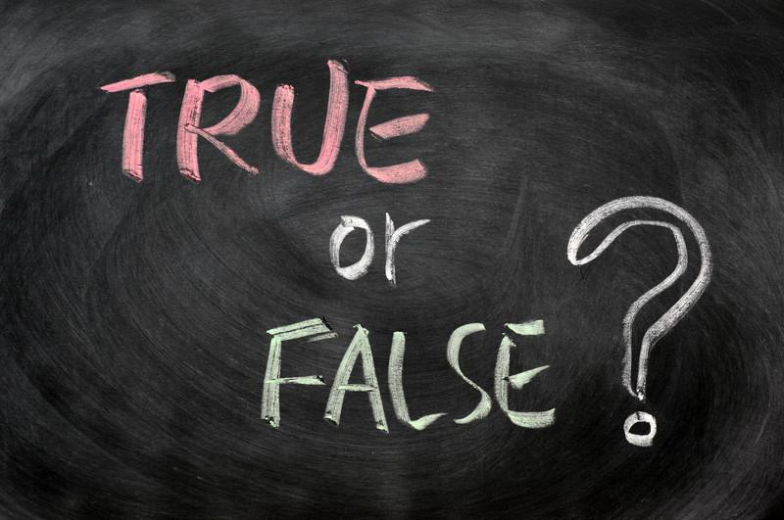
Research shows that L2 learners tend to focus more on language forms (e.g., verb endings) whereas heritage learners tend to focus more on communicative content.
HL learners want to have their errors corrected.
In mixed classes, HL and L2 learners generally have negative perceptions of each other.

Slide 10
Research shows that L2 learners focus more on language forms (e.g., verb endings) whereas heritage learners focus more on communicative content.
HL learners have a different orientation to the language and to language tasks than L2 learners do, and this may have an impact on learning outcomes.
HL learners are used to using the language to communicate, not to analyzing it.
Two studies (Gass & Lewis, 2007; Torres, 2013) found that when HL learners received recasts of errors they made, they were unlikely to perceive them as corrections.
They thought the recasts were comments on content.
L2 learners were far more likely to perceive the recasts as corrections.

Slide 11
In a recent study (Bowles, in preparation) I also found that HL learners engaged in a treatment on the use of the subjunctive in adverbial clauses were less likely to actively hypothesis test and try to find patterns when receiving feedback. L2 learners did this almost systematically.

Slide 12
Sample Form Item
Voy a participar mucho cuando…
trabajo en grupo.
trabaje en grupo.
[After selecting A or B, learners saw “Correct!” or “Incorrect!” on the screen]

Slide 13
Sample Meaning-Based Follow-Up
¿Quién lo diría?
A. Una estudiante buena
B. Una estudiante mala
C. Los dos

Slide 14
Low-scoring HL learners answered based on intuition and weren’t actively hypothesis testing or using the feedback to check their intuition:
Post-instruction interview responses:
“I went with which one sounds better, but it seemed like both sounded equally good or the one that sounded best was wrong” (participant 921)
“I formed it in my head and followed that rule” (participant 917)
High-scoring HL learners formulated hypotheses:
“Getting feedback was good, it helped me figure out that when words ended in –e it was gonna be in the future” (participant 925)

Slide 15
Additionally, HL learners commented much more often (and more extensively) on the meaning-based follow-up question than they did on form.
85% of HL learners made comments on the content question; only 15% of L2 learners did:

Slide 16
Sample excerpt from post-instruction interview:
“Sabes qué, some of those questions about what kind of student would do each action were hard…I was really thinking a lot about that part.”

Slide 17
Torres (2018)
In a task-based intervention on the subjunctive in adjectival clauses (with no explicit rule presentation) Torres (2018) compared HL and L2 groups.
L2 learners showed larger gains than HLs from pretest to posttest.
Orientation to the tasks was very different in the two groups:
L2 learners were form-oriented and engaged in extensive hypothesis testing: they used the task to make form-meaning connections
HLs were not form-oriented and instead focused on the content

Slide 18
HL learners want to have their errors corrected.
Ducar’s (2008) survey of 152 students enrolled in an intensive SHL program revealed that an overwhelming majority (91%) wanted to have their errors corrected.
This runs counter to the anecdotal belief that correction might discourage students or deter them from wanting to continue taking HL classes.

Slide 19
In mixed classes, HL and L2 learners generally have negative perceptions of each other.
Bowles and Montrul (2014) survey of HL learners’ perceptions
When asked whether they preferred to be in a Spanish course just with other HL learners
Course preference:
25% with HL learners
75% with L2 learners/no preference
Martín (2017) found that after being enrolled in a mixed class for one semester, the two groups had positive attitudes toward each other.

Slide 20
Even those who started out the semester saying they preferred separate classes spontaneously indicated benefits of being in a mixed class on a questionnaire at the end of the semester.

Slide 21
Although we are far from having all the answers, we can draw some implications from the existing research for classrooms that enroll L2 and heritage learners.

Slide 22
Don’t assume
…what learners’ goals or motivations are.
…that just because of the context in which HLs learned Spanish that they don’t need to develop their speaking (Swender et al., 2014)
All 4 skills are important for all learners, although the starting points are different.

Slide 23
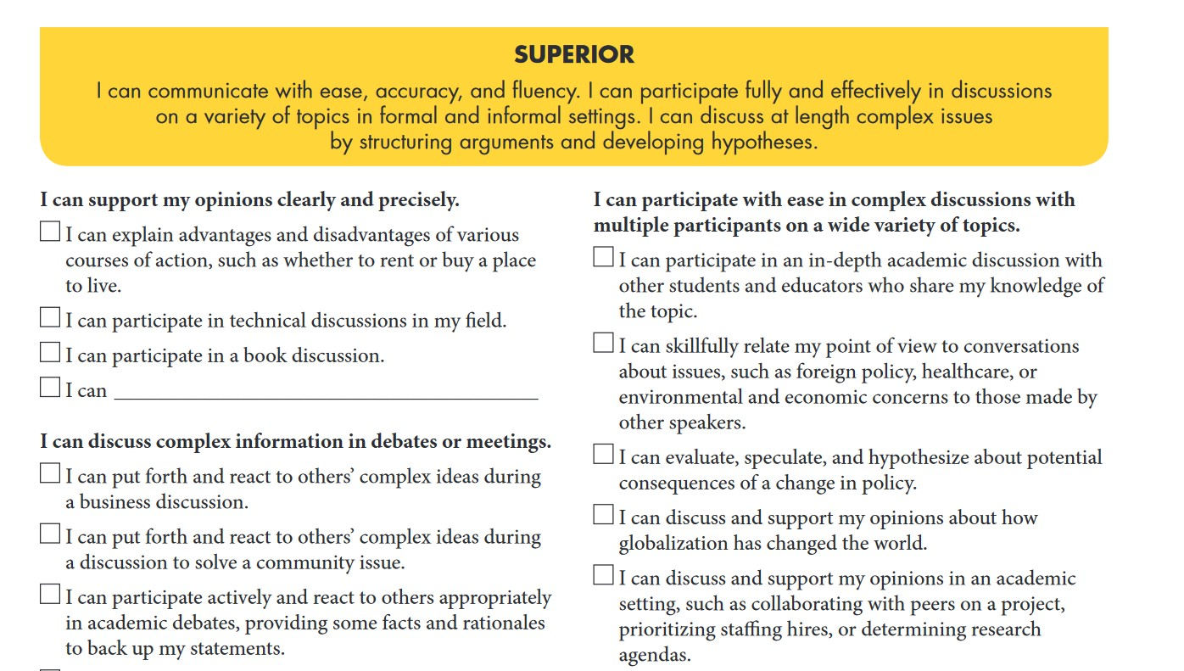

Slide 24
Be realistic!
We don’t expect L2 learners to improve dramatically overnight – and we shouldn’t expect it of HL learners either.
For a point of reference, even native monolingual speakers of English in composition classes make small gains over one semester (Biber et al., 2011).

Slide 25
Teach about language attitudes!
Since people make assumptions based on the way we speak, it is important to teach everyone (L2 and HL learners alike) about how language choices affect them.
Critical language awareness (Leeman, 2002; Mendoza, 2018)
Have students explore how different registers are used and what language features they have.

Slide 26
This approach gives students the tools they need to make informed decisions about how they use language and with whom, for what purposes.
Maintain a home variety and a colloquial register and be able to shift to a more formal (and possibly standard) variety in other situations
Good for HL and L2 alike!

Slide 27
Incorporate a variety of topics/themes into your teaching
Some heritage textbooks focus on a limited set of themes and these deny the multifaceted realities of our learners
“Why are we always talking about immigration? I’m American!”

Slide 28
Focus on form
Focus on formS
Focus on meaning
Linguistic forms
Linguistic forms within a meaningful context
Meaning
Focus on form (FonF)

Slide 29
Focus on form – just right?
Research (mainly from early studies on Canadian immersion classrooms) found that FoM left (L2) learners with good comprehension and fluency but lots of errors.
FonFS tended to focus on formS in isolation, so (L2) learners didn’t become very fluent
= (lots of explicit knowledge about the language and little implicit knowledge of it.)

Slide 30
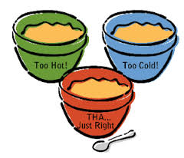
FonF seems to be the “Goldilocks” combination – focus on particular linguistic forms in a meaningful context.
Planned vs. incidental FonF

Slide 31
So what does it mean to focus on form?
No, this doesn’t mean drill, baby drill!
It also doesn’t mean divorce meaning from form.
It means drawing attention to particular language forms in a meaningful context.

Slide 32
HL learners may need to be oriented more explicitly to attend to form than L2 learners (but L2 learners have been shown to benefit too).
That’s why it’s perfect for mixed classes!

Slide 33
Some appropriate approaches that lend themselves to focus on form include
Content-based instruction (e.g., “Spanish in the Professions”)
Project-based instruction (Buck Institute for Education)
Students work together to create a product that responds to a real need (authentic, provides student voice and choice and incorporates models)
- Community-based service learning (Abbott, in press; Pascual y Cabo, Prada & Ramírez, 2017)

Slide 34
Techniques
Some focus on form techniques (remember: these must be embedded in meaning-based communication)
Input flood
Input enhancement
Oral corrective feedback
Task-based paired interaction
Explicit pre-task rule-based instruction

Slide 35
As long as the attention is shifted to form in the context of meaning-making (and not just for the love of form itself) it is focus on form!

Slide 36
Some examples
Context: upper-level mixed class titled “Bilingualism”
Enrolls HL and L2 learners – most at intermediate high/advanced low level
Learning about and discussing bilingualism as an individual, cognitive, and social (collective) phenomenon

Slide 37
Students read about primary research in Spanish and relate it to their own experiences
Content-based course, so forms are embedded in the content itself
No particular explicit emphasis on any set of language structures, although some are common and recurring

Slide 38
Two issues with form that I noticed:
Aspect (use of preterit/imperfect in the past):
In bilingual profiles
In reporting results of studies
Making comparisons
In comparing different groups’ language policies or use
Superlatives

Slide 39
Two different focus on form techniques:
Preterit vs. imperfect in bilingual profiles (input flood)
Students read a series of bilingual profiles with lots of preterit and imperfect forms embedded and answered questions based on the terms we had been studying
¿Qué es la lengua primaria de Maribel?
¿Qué es la primera lengua de Maribel?

Slide 40
Then after we discussed the bilingual profiles (one of a sequential bilingual and one of a simultaneous bilingual) the students each wrote their own, loosely based on the models.
Were they were raised
What languages they spoke
Whether their language use/dominance changed and when

Slide 41
Then they read their profiles to their partners, who had to fill out a grid
Finally, several students shared their profiles and I offered corrections to the aspect where needed

Slide 42
Comparatives
This structure is not as frequent as preterit and imperfect, so I provided a short lesson on how to form comparisons in Spanish.
The lesson provided models that the students could refer to.
Hay más de 350 lenguas habladas en los EEUU.
En las familias bilingües, los hermanos mayores suelen hablar la lengua minoritaria mejor que los hermanos menores.

Slide 43
Then we moved into the topic for the day, a comparison of sequential and simultaneous bilinguals.
We also recycled later in the semester, making more comparisons (e.g., among minority languages in Spain and Latin America).

Slide 44
You probably noticed in these examples that the language forms being targeted were essential for task completion.
You can’t successfully make comparisons without comparativos y superlativos.
You also can’t describe a person’s linguistic history without aspect.

Slide 45
Focus on form works best in these cases, where the language is task-essential.
Task-natural Task-useful Task-essential
(Loschky & Bley-Vroman, 1993)

Slide 46
‘Grammar’ (morphosyntax) isn’t the only thing that can be the object of focus on form.
You can do focus on form with any language feature – vocabulary, phonology, pragmatics – you name it!

Slide 47
One thing both L2 and HL learners need to develop is understanding of register (formal/informal)…but often in opposite directions!
A way to focus on form would be to have students work together to transform an informal message (e.g., blog post) into more formal language and vice versa.

Slide 48
Guided discussion of the features that make the text (in)formal.
Two types of learners can complement each other – L2ers are stronger with formal language and HLers are stronger with informal, colloquial language.

Slide 49
Excellent resource for lessons introducing students to topics in sociolinguistics/language attitudes:
Empowering Learners of Spanish (University of Oregon)
https://tinyurl.com/empowerspanish

Slide 50
See the glass as half full!
Rather than seeing L2 and HL learners’ weaknesses or deficiencies, let them build on their strengths.
Pairing L2 and HL learners together:
“put us together and we make a great Spanish team!” (Bowles, 2011)
Incorporating a range of oral and written activities; sometimes start with reading, sometimes with listening

Slide 51
Lesson planning
Think-pair-share
Start with communicative goals: What do you want your learners to be able to DO in Spanish?
Then think…what language do they NEED to achieve that goal?
Your target for focus on form should emerge from the answers to these questions.

Slide 52
With that in mind…
What is the meaningful context in which the target language form is embedded?
Is the language form task-essential (or at least task-useful)?
What focus on form technique fits best?
Remember: you can start with an existing task or create one from scratch

Slide 53
¡Manos a la obra!

Slide 54
Objectives
Part 1
Understand key research findings about instructed heritage language acquisition
Understand what research tells us about mixed classes
Be able to articulate why focus on form is important
Be able to identify what techniques are focus on form and what techniques are not
Part 2
Plan a lesson including focus on form appropriate to your students’ goals, needs, and level

